Slide 1
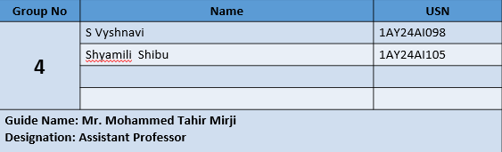
Department of Artificial Intelligence and Machine Learning Acharya Institute of Technology Soladevanahalli, Bengaluru 560 107 Flipped class presentation is on
MULTITHREADING
Presented by
Dept of Physics

Slide 2

Background of Multithreading?
Multithreading is the ability of a program to run multiple threads concurrently
Threads execute independently but share the same memory
Example: Web Browser
One thread loads web pages
One thread plays video
One thread handles user input
Dept of Physics

Slide 3

What is a Thread?
A thread is the smallest unit of execution in a program
Multiple threads exist within a single process
Threads share:
Memory
Resources
Lightweight compared to processes
Example: Music Player
Thread 1: Play music
Thread 2: Display lyrics
Thread 3: Adjust volume
Dept of Physics

Slide 4
HOW TO CREATE MULTIPLE THREADS Multiple threads are created within a single process so tasks can run concurrently. General Steps to Create Multiple Threads: Define the task (thread function) Each thread executes a specific function or set of instructions. Create thread objects A separate thread is created for each task. Start the threads Once started, threads move to the ready state and wait for CPU time. Execute concurrently The operating system schedules the threads for execution.
Dept of Physics
(Synchronize if needed)
Terminate threads Threads end after completing their execution.

Slide 5
MANAGING MULTIPLE THREADS:
Thread Scheduling:
The OS decides which thread runs next based on priority and time slicing.
Thread Synchronization:
Ensures safe access to shared resources using locks, mutexes, or semaphores.
Context Switching:
The CPU switches between threads to provide concurrent execution.
Thread Communication:
Threads communicate through shared memory and synchronization mechanisms.
Thread Termination:
Threads are terminated after completing their task or by force.

Slide 6
Creating Threads
class MyThread extends Thread {
public void run() {
System.out.println("Thread running");
}
}
MyThread t = new MyThread(); //start() begins thread execution
//run() contains thread codet.start();
Creating multiple threads
pthread_t t1, t2; // Declare thread variables
pthread_create(&t1, NULL, func, NULL); // Create first thread
pthread_create(&t2, NULL, func, NULL); // Create second thread
pthread_join(t1, NULL); // Wait for first thread to finish
pthread_join(t2, NULL); // Wait for second thread to finish

Slide 7
Real-World Applications of Multithreading
1. Web Browsers
One thread loads web pages
Another handles user input
Another plays audio/video
Browser stays responsive
2. Operating Systems
One thread manages user processes
Others handle I/O, memory, and scheduling
Smooth multitasking
3. Video Games
One thread for graphics
One for sound
One for player input
Real-time performance
4. Banking Systems
Multiple threads process transactions simultaneously
Handles deposits, withdrawals, and balance checks
Faster service, no waiting

Slide 8
INTERACTIVE SESSION
Why do we create multiple threads in a single process?
What is thread synchronization?

Slide 9


Slide 10




Overveiw
Acharya stands as a beacon of excellence in higher education, boasting a legacy of academic distinction since its establishment in 1990. We offer a transformative educational experience, fostering holistic development, nurturing innovation and providing world-class facilities to ensure an enriching journey for our students.
Dept of Physics

Slide 11


11 Institutions, Infinite Possibilities
We provide 100+ programs across 50 academic streams.
Dept of Physics

